Slide 1
BANK LOAN MANAGEMENT
Presented By:
Lavanya Raju Bheemini (14439)
Namita Dilip Jagtap (14432)
Nikita Fatehlal Chandaliya (14429)
Riya Jatin Shah (14447)
Sai Sohita Parimi (14450)
Presented On: 31/07/2019

Slide 2
INTRODUCTION
The main objective of developing this project is to handle all the details of Loans and Investments in the bank.
Our proposed project automates the loan process from both, bankers as well as customer’s. Customer can apply for a loan and after approved it they can track their details from online.
Using with this system admin can find customer details easily and he has to approve the loan.

Slide 3
INSIGHTS
A wide range of technologies involved in this course and project development are:
Front-end: Html/CSS, Bootstrap, Angular 8
Back-end: Java 8, Spring Boot, Spring Security, Hibernate, MySQL
Front End | Back End
HTML/CSS : For developing forms and pages. | Java 8 : Object oriented language
Bootstrap: For creating cards. | Spring Boot : for building stand-alone applications.
Angular 8: Angular is open source for front-end JavaScript Framework | Spring Security : Access control framework.
 | Hibernate : ORM tool.
 | MySQL: Database.

Slide 4
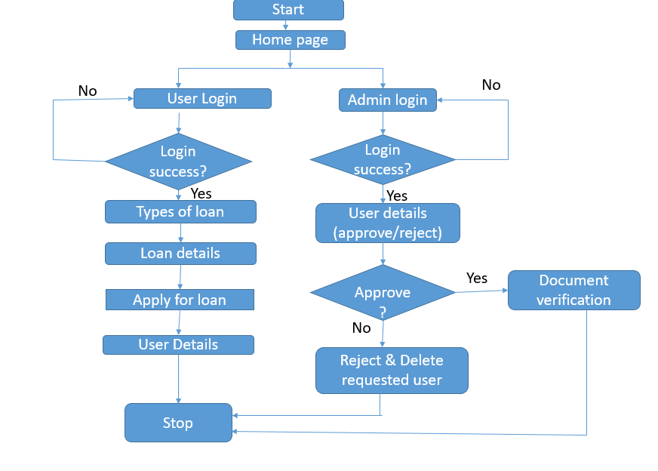
FLOW CHART

Slide 5
INNOVATION & BUSINESS FEATURES
Role based authentication and authorization using JWT.
Calculating interest to be applied on the loan amount.
The entire loan process is digitalized.
It reduces customer’s time of visiting the bank and going through all the paperwork at specified bank time.
The loan interest is calculated and provided to user on the spot and the user gets the clarity about how amount he/she should apply for the loan.

Slide 6
ISSUES FACED AND SOLVED
ISSUES FACED | SOURCES TO SOLVE
Issues faced while integrating. | Solved by consoling and by browsing the errors in Google.
CORS Errors. | Solved with the help of mentors.
Http Errors.

Slide 7
THANK YOU

